Slide 1

McGraw-Hill Technology Education
Copyright © 2006 by The McGraw-Hill Companies, Inc. All rights reserved.

Slide 2
Chapter 12B
Building Information Systems

Slide 3
Systems Development Life Cycle
Organized way to build information systems
Consists of five phases
  Entire usable life of the system

Slide 4
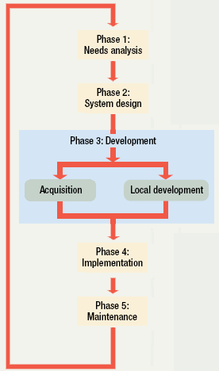
SDLC

Slide 5
Systems Development Life Cycle
Phase 1: needs analysis
  Users identify a need
  Solves three main problems
    Define the problem
    Present possible solutions
    Determine the best solution
  Technology analysts talk with users
  Define the problem using a description tool
  A solution is presented to a manager
Notes:
Teaching tip
Structured English is covered in chapter 13. The term used is pseudo code.

Slide 6
Systems Development Life Cycle
Phase 2: Systems design
  Solution is defined
    Data storage
    User interface
    Reports
  Several design tools
    Top down design
    Bottom up design
  CASE tools used to build prototypes
    Computer aided software engineering

Slide 7
Systems Development Life Cycle
Phase 3: Development
  Solution to the problem is built
  Programmers play a key role
  Solutions may be purchased
  Solutions may be built locally
  Technical writers create instructions
  Solution is repeatedly tested
Notes:
Teaching tip
Companies understand the SDLC and attempt to work with clients to provide the program they need. Oracle for instance has several add-ons for its core DBMS lines. Oracle financials, for instance, allows companies to completely track and maintain it’s cash flow and costs.

Slide 8
Systems Development Life Cycle
Phase 4: Implementation
  Installation of hardware and software
  Users must convert to the solution
    Direct conversion
    Parallel conversion
    Phased conversion
    Pilot conversion
  Trainers and support personnel are critical
Notes:
Teaching tip
Pilot programs are often referred to as beta testing. The beta testers work with the product to guarantee that it is ready for release.

Slide 9
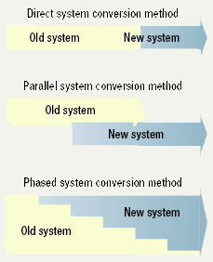
SDLC Conversion

Slide 10
Systems Development Life Cycle
Phase 5: Maintenance
  IT professionals continue to monitor
  Bugs are fixed
  New features are added
  Users often suggest bugs or features
Notes:
Teaching tip
Microsoft continues to maintain their products, sometimes years after launch. Windows XP recently received its second service pack while Windows 2000 is on it’s fourth.

Slide 11
Evolving System Design Methods
Problems with SDLC
  SDLC is an old process
  Very slow process
  Companies need to respond quickly

Slide 12
Evolving System Design Methods
Rapid Application Design (RAD)
  Develops IS systems quickly
  Several products exist
  Slightly different development phases
Notes:
Teaching tip
Microsoft Visual Basic is one tool often associated with RAD.

Slide 13
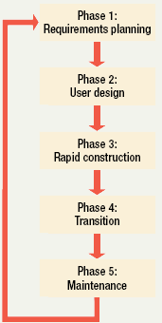
RAD SDLC

Slide 14
Evolving System Design Methods
RAD Phase 1: Requirements planning
  Requirements for project are defined
  Joint requirements planning (JRP)
    Involves programmers and managers
  Managers from affected departments provide guidance

Slide 15
Evolving System Design Methods
RAD Phase 2: User design
  Joint application design (JAD)
    System analysts and users
  User provides the details
  System analyst solve the technical details
Notes:
Discussion point
Have the students discuss the usefulness of user input in the design phase. Discuss both pros and cons.

Slide 16
Evolving System Design Methods
RAD Phase 3: Rapid construction
  IS professionals develop the project
  A variety of tools can be used
  Users approve each portion

Slide 17
Evolving System Design Methods
RAD Phase 4: Transition
  System is tested on sample data
  Users are trained on the sample
  New system runs parallel to existing
  Phase complete when bugs are gone
  Old system removed

Slide 18
Evolving System Design Methods
RAD Phase 5: Maintenance
  Traditionally not part of RAD
  All systems need periodic maintenance

Slide 19
Evolving System Design Methods
Object Oriented Systems Analysis
  OOSA
  Project elements are defined using objects
    Objects are self contained programming constructs
    Objects have data and functionality
  Objects are linked together
  Java and C++ are typical tools

Slide 20
Chapter 12B
End of Chapter

